Slide 1
Azure Immersion Workshop: Infrastructure Migration
Session 1: Azure migration overview: Optimize costs and migrate with confidence
July 2020
Speaker Name

Slide 2
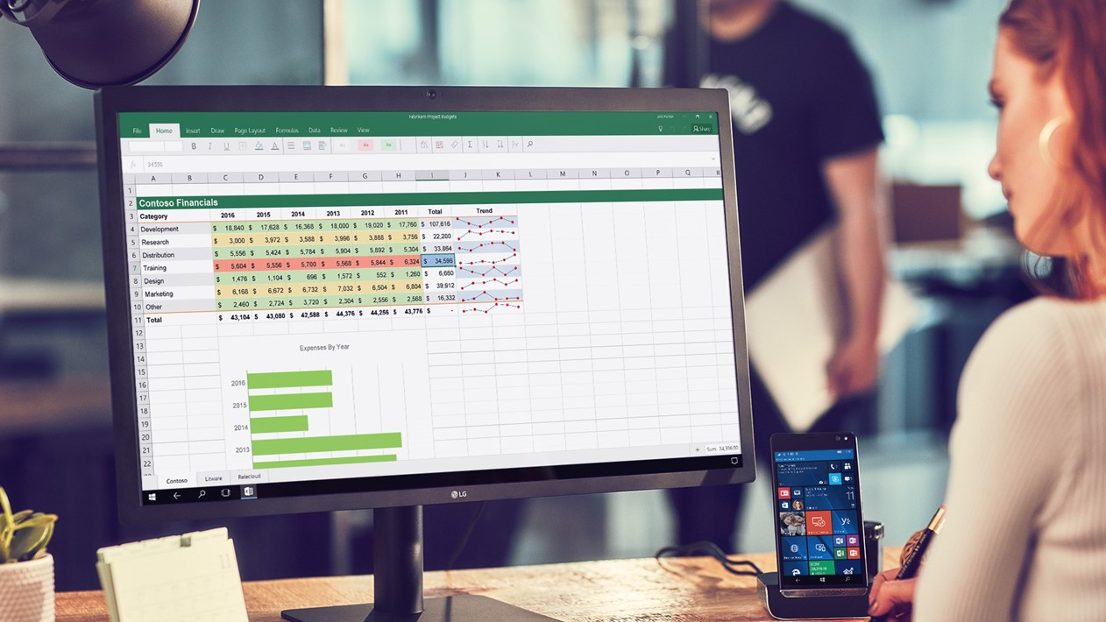
Economic pressures
Notes:
Every customer that we speak to is facing headwinds and economic challenges in this macro environment.

Slide 3
Top of mind
How can I ensure my business continues to run without interruptions?
How do I address here and now need and prioritize next set of IT priorities?
How can I secure my network and assets from attackers during these already tough times?
Should I reconsider running my own datacenter given resource/financial constraints?
How do I build the case to invest in the right areas so we’re better prepared for next time?
How will my staff adapt to the steep learning curve with new technologies?
Notes:
These are the top of mind concerns and challenges we are hearing from IT leaders.

Slide 4

Cybersecurity threats
Cash flow challenges
Business continuity
Rapidly scale web apps and infrastructure
Cloud migration
triggers
Budget and resource constraints
Datacenter contract expiry
Notes:
These are the typical triggers that are making customers look at cloud migration during these challenging times.
Common ones include:
Cash flow challenges – This includes cash flow challenges not just for our customers, but also their entire ecosystem (e.g., suppliers, distributors, end customers).
Cybersecurity threats – Customers are feeling more vulnerable to attackers, their defenses are down
Scarce IT budgets/resources – Customers are reporting the need to free up IT $s to invest into other parts of the business that may need it more
Ability to meet surge demand – Several industries such as healthcare, retail are seeing a surge in demand. They are finding that their existing systems and solutions just can’t keep up.
Business continuity – Customers have real concerns about their day to day operations being interrupted (e.g., network connectivity, data loss)
Datacenter contract expiry – Many customers we speak to are viewing contract expiry as an inflection point to consider cloud migrations (“is it worth running my own given resource/cash flow challenges”?)

Slide 5
How can migrating to the cloud help?
Flip CAPEX to OPEX, pay as you consume
Enhance your organization’s
security posture
Scale to what’s needed, focus on what matters
Notes:
Moving to the cloud has clear economic benefits.
- Convert upfront capital expenditures into operating expenditures and pay as you consume.
- Security is now a reason to migrate to the cloud – customers see that cloud providers can help them improve their security posture (critical during times of vulnerability).
- The cloud scales up and down to meet demand as you need, so you don’t need to over-provision resources to be ready for peak usage and incur expenses on idle servers.
- Best of all, the cloud improves operational productivity for your staff, so they can focus on priority business initiatives.

Slide 6
Migrate to Azure efficiently on your own terms
Optimize costs and migrate with confidence
Stay secure and resilient across hybrid environments
Scale your applications and workloads on-demand
Notes:
Azure offers a comprehensive mix of technology, best practice guidance, programs, offers, and tools to migrate your entire datacenter to the cloud. Migrate with confidence and optimize your costs with our on-demand global infrastructure with the most regions of any cloud vendor.
Azure is the best cloud destination for your servers, applications, and databases. Our cost saving offers and capabilities are hybrid by design, knowing that you will likely operate that way for the foreseeable future. With Azure, you can be confident that you are running your Windows and SQL workloads at the lowest total cost of ownership versus competitors. Migrate your proprietary or open source databases, modernize your applications, and optimize your costs in the process. In addition to delivering a competitive total cost of ownership (TCO), customers can secure their workloads with industry leading intelligence and built-in security controls. Your business is no longer hostage to the capacity of your data center, and customers can scale their applications on demand to meet the business demands of tomorrow, without having to worry about infrastructure management.
Microsoft Azure is investing in areas to help you weather the crisis and set you up for resilience in the long term.
Optimize costs and migrate with confidence
Save money and realize operational efficiencies with hybrid offers on Windows Server and SQL Server, comprehensive datacenter migration programs, and optimized infrastructure. Whether it’s Microsoft workloads like Windows Server or SQL Server, or Linux or open source databases, you can leverage curated guidance and best practices to migrate with confidence.
Lower migration costs and risk with best practice guidance & resources [AMP | FTA | CAF]
Gain substantial savings on WS & SQL, AWS is 5x more expensive [Azure Hybrid Benefit, free ESUs, superior SQL Server price-performance]
Stay optimized with free migration and cost management tools + offers [Azure Migrate, Azure Billing & Cost Management, Azure Advisor, Reserved Instances, Spot VMs]
Unmatched security, built-in resiliency
Take advantage of multi-layered hybrid security in Azure. Rely on a cloud that is built with customized hardware, has security controls integrated into the hardware and firmware components, and added protections against threats such as DDoS.
3500 security experts, $1B/yr investment
Ensure maximum resilience with built-in HA/DR [AZs, DC pairing, ASR/Azure Backup]
Secure your org from threats with cloud-native SIEM that can be accessed from anywhere [Azure Sentinel]
Protect your cloud workloads with context from >8T threat signals processed per day [Azure Security Center]
On-demand scale and ops efficiencies
Use the cloud to scale your web applications and meet business demands of today and tomorrow. Leave the operational work to us so you can stay focused on what matters. Future proof your business with on-demand scale, always up to date databases, and innovative managed services that are always on.
More DC regions than any other cloud provider [58 regions]
Flexible, best-in-class infrastructure for any workload [Azure IaaS, >150 VM sizes]
Use built-in autoscaling for your web sites to seamlessly fulfill customer demand [Azure App Service]
Drive operational efficiencies with a fully managed web and database platform [Azure App Service, Azure SQL]
Hybrid flexibility and efficiency
Extend Azure management to any infrastructure for efficiencies [Azure Arc]
Reuse your on-premises investments in the cloud [Azure Hybrid Benefit]
Efficiently manage Windows Server wherever it resides [Windows Admin Center]
Max SQL compatibility and ops consistency [Azure SQL]

Slide 7
Optimize costs during and after migration
During migration
Post migration
Model on-premises vs. Azure costs using the Azure TCO Calculator
Right-size Azure resources based on assessment guidance from Azure Migrate
Use Azure Hybrid Benefit & Azure Reserved Instances to save money
Join the Azure Migration Program to save on migration costs
Use best practice recommendations to save (e.g., shutdown idle resources) with Azure Advisor
Implement cost controls with Azure Policy so your teams can go fast with control
Monitor your bill, set budgets, & allocate spending with Azure Cost Management
Notes:
Cloud cost optimization is always important, and now more than ever. During this challenging time, companies and organizations around the world are facing difficult decisions about how to meet their funding needs for critical IT projects.
You can also forecast costs for future investments with the Azure TCO calculator.
You can use assessment guidance from Azure Migrate to rightsize your on-premises resources as you move them.
To cost optimize your workloads, you can use services like Azure Advisor to find actionable best practice recommendations for cost savings. The Microsoft Azure Well-Architected Framework provides guidance on how to design and architect your workloads for cost efficiency. We also have many offers like the Azure Hybrid Benefit and Azure Reservations that can help you save.
To understand and forecast your costs, you’ll rely on Azure Cost Management, where you can monitor your bill, set budgets, and allocate spending to your teams and projects.
Finally, to control your costs, you can put in place policies that ensure your teams will comply with your guidance using Azure Policy. For help on setting policies, you can turn to the Microsoft Cloud Adoption Framework for Azure.

Slide 8
Pay less with Azure. AWS is 5x more expensive.
Windows Server savings illustration
Azure Hybrid Benefit Savings
ESU Savings
Azure
AWS
Windows VM
Extended security updates
SQL Server savings illustration (PaaS)
Azure Hybrid Benefit Savings
AWS
Azure
AWS
Azure SQL Database
AWS RDS for SQL EE
Why run Windows Server and SQL Server anywhere else?
Learn more: aka.ms/why5xmore
Notes:
Pay less. AWS is 5X more expensive than Azure for Windows Server and SQL Server. Unique offers like Azure Hybrid Benefit and Free Extended Security Updates makes this possible.

Slide 9
SQL Server: Best price-performance on Azure IaaS
SQL IaaS Performance
GigaOm Benchmark | Jan 2020
SQL IaaS Price-Performance
GigaOm Benchmark | Jan 2020
$390.97
698.07
3.6x faster
84% less
3-year pricing / tps
Transactions per second (tps)
194.08
$61.64
AWS
AWS
Greater performance (3.6x faster) and lower price per transaction (84% cheaper)
E32as_v4 Azure VMs VS. r5a.8xlarge AWS instance
Notes:
Furthermore, a price-performance benchmark study conducted by GigaOm shows that SQL IaaS achieves nearly 4 times faster performance and up to 84% lower price per transaction on Azure than on AWS. The performance profiling exercise was done running SQL Server on Azure and AWS EC2, using the latest AMD-based VMs on both cloud platforms.
The great performance and cheaper cost of SQL IaaS on Azure were a result of the great price/performance of Azure VMs and our unique Azure Hybrid Benefit.
Additional notes (presenter reference only):
And you may have seen AWS’ blog published by an AWS employee trying to claim that SQL IaaS runs best on AWS. That is not the case.
TPC-C is now well past ‘legal drinking age’ unlike TPC-E it does not reflect modern workloads: AWS is promoting benchmarks that are no longer relevant in today’s customers’ environments. This bullet point alone would put the debate to rest.
The TPC-E numbers on Windows that Giga produced for AMD-based VMs show once major advantages for Azure both in terms of performance and price/performance and compare the latest gen of AMD-based VMs on both platforms.
They used Ultra Disks in their comparisons, which constitute a very small percentage of our base, nonetheless the figures GigaOM has already published with TPC-E make us look better that AWS even when using Ultra Disks
BenchCraft is the tool used by every vendor that published officially audited TPC-E results, (as you can see from the supporting files indexes). The tool has been audited by TPC.ORG. Claiming that BenchCraft is ‘opaque’ or insinuating that is ‘rigged’ is preposterous.
We do not have the same issue with the benchmark that we may publish on AMD VMs, but the SQL team has already repeated the existing GigaOM benchmark with striping and the results are still very favorable to us (2.7x better performance).

Slide 10
Start with a secure, trusted foundation
$1B+ annual investment
3500+ security experts
Trillions of signals analyzed for intelligence
Notes:
Azure provides a strong secure foundation to strengthen your security posture across operations, technology and partnerships.
At Microsoft, we:
Invest $1B annually in cybersecurity
Have over 3500 global security experts to monitor and secure the environment Azure resources
Benefit from the Microsoft Intelligent Security Graph, which uses trillions of signals from Microsoft services and systems around the globe to identify new and evolving threats.

Slide 11
Rely on multi-layered security controls across hybrid environments
Security management
Manage security state of hybrid workloads with a single view
Threat protection
Access cloud-native SIEM and AI-driven security analytics
Identity & access
Unify identity management and secure identities to implement zero trust
App and data security
Encrypt data, and protect keys and secrets used by apps
Network security
Enhance the protection of your virtual networks
|
|
|
|
|
Azure Sentinel
Azure Security Center
Azure Active Directory
Azure Key Vault
Azure Firewall & DDoS
Notes:
You can rely on multi-layered hybrid security in Azure – be it customized hardware or security controls integrated into hardware and firmware components. Protect your cloud workloads with context from >8T threat signals processed per day. Secure your entire org with cloud-native SIEM accessed from anywhere.
Our Identity and Access Management tools enable you to take an identity-based approach to security, and establish truly conditional access policies​
Our App and Data Security help you protect your apps and your data as it moves around—both inside and outside your organization​
Network security: Establish secure connections to and within Azure using virtual networks, network security groups, VPN, and ExpressRoute. Protect and ensure availability of your apps, protect against network layer threats with services like Web Application Firewall, Azure Firewall and Azure DDoS Protection
Threat protection - Secure your entire organization from threats with Azure Sentinel - a cloud native SIEM (Security Information and Events Management) - that scales to your needs and can be accessed from anywhere.
Security Management: It is important to assess security state continuously, especially as cloud workloads change dynamically. Azure Security Center will help you monitor security state of Azure resources and hybrid workloads. It will provide a dynamic security score card and recommendations to improve your security in a centralized console making security management easier across different resources. And you get advanced threat protection across many services like virtual machines, servers, apps, Azure SQL, Storage, containers on VMs – backed by Microsoft Intelligent Graph you are able to detect and respond to threats quickly across these services. Plus, manage data across your enterprise with Azure Sentinel.
Finally, take advantage of extended security updates and integrate with our many partner solutions. These are the solutions that you can use to get further enhanced protection for your Azure and hybrid workloads quickly.

Slide 12
Azure Hybrid
Innovation anywhere with Azure
Azure
Single control plane with Azure Arc
AWS
VMware
Google Cloud
Bring Azure services to any infrastructure
Modernize datacenters with Azure Stack
Extend to the edge with Azure IoT
Notes:
Azure takes a comprehensive approach and offers unique hybrid capabilities that give customers the flexibility to innovate anywhere in their environment.
Enabled by Azure Arc, you can bring Azure services to any existing infrastructure including other clouds you are using, so you can take advantage of cloud benefits everywhere, such as scalability, fast deployment, and always up-to-date cloud innovation.
You can build Azure-consistent new cloud infrastructure in your own datacenter with Azure Stack, so you can modernize your datacenter and run cloud native applications on-premises while taking advantage of existing investments and meeting regulatory compliances.
You can extend AI to edge devices with Azure IoT, so you can run machine learning and advanced analytics close to the users and the data. As a result, you can gain real-time insights and deliver immersive experiences at the edge of your network, opening up endless new business opportunities.
And you can do it all using Azure Arc as the single control plane to seamlessly manage and secure your IT resources, such as Linux/Windows VMs and Kubernetes clusters, across multicloud, on-premises and the edge.
Now let’s take a deeper look at the three hero Hybrid offerings: Azure Arc, Azure Stack and Azure IoT

Slide 13

Enhanced business continuity across hybrid environments
One-click backup for VMs and databases with
Azure Backup
Data encryption & multi-factor authentication with Azure Backup
Recover data and apps quickly and reliably
with Azure Site Recovery
Connected branch offices, datacenters, cloud
with Azure Virtual WAN
High Availability
High Availability
SLA 99.9% Isolated VM failure
SLA 99.95% Hardware failure
SLA 99.9%
Entire datacenter failure
Minimal RPO/RTO
Entire region failure
Notes:
Azure offers built-in backup and disaster recovery services that are easy to deploy, cost-effective, secure, and scalable, providing you with an end-to-end business continuity solution.
In the case of a disruption, whether it’s ransomware, data deletion or corruption due to human errors or outages, you can recover your apps and data in a timely and reliable manner.
An IDC study showed that compared to on-premises backup and disaster recovery solutions, customers that used Azure Backup and Azure Site Recovery achieved significant improvement in business operations, with an estimated 337% ROI in 5 years.
With Azure, customers can also enjoy high availability. From a single virtual machine to a datacenter to an entire region, we have guaranteed SLAs and industry leading RPO (Recovery Point Objective) and RTO (Recovery Time Objective). In fact, the average Azure VM uptime was 99.998% rolling 12 months to April 2020.
Additional notes:
Azure provides built-in solutions for customers to implement simple, secure and cost-effective Business Continuity and Disaster Recovery (BCDR) strategies for their applications and data. Once enabled, customers benefit from minimal maintenance and monitoring overhead, remote management capabilities, enhanced security, and the ability to immutably recover business services in a timely and orchestrated manner. Customers can also use the preferred backup provider of choice and take advantage of built in Azure integrations to extend their on-premises BCDR solutions to Azure. All of this is possible without the need to learn new tools for configuration or management.
Azure Backup is designed specifically to back up and restore data, and Azure Site Recovery is designed to perform seamless application disaster recovery. Together, these services provide an end-to-end solution that can be implemented and scaled with just a few clicks.
By not having to build on-premises solutions or maintain a costly secondary datacenter, users can reduce the cost of deploying, monitoring, patching, and scaling disaster recovery infrastructure. Azure Backup automatically allocates and manages backup storage with flexible policies to optimize cost and meet business objectives. Users can add or remove managed resources through the Azure portal as storage needs fluctuate over time. Together, Azure Backup and Azure Site Recovery use the underlying power and unlimited scale of the cloud to deliver high availability with minimal maintenance or monitoring overhead. These native capabilities are available through a pay-as-you-use model that bills only for the storage that is consumed.
For further simplicity, Azure’s centralized management interface for Azure Backup and Azure Site Recovery makes it simple to define policies to natively protect, monitor, and manage a wide range of enterprise workloads including Azure Virtual Machines, SQL and SAP databases, on-premises Windows servers and VMware machines. Using Azure Site Recovery, users can set up and manage replication, failover, and failback from a single location in the Azure portal. The Azure hybrid services tool in Windows Admin Center can also be used as a centralized hub to easily discover all the available Azure services that bring value to on-premises or hybrid environments. Windows Admin Center streamlines setup and the process of replicating virtual machines on Hyper-V servers or clusters, making it easier to bolster the resiliency of environments with Azure Site Recovery's disaster recovery service.
Azure is committed to providing the best-in-class data protection to keep your applications running. Azure Backup protects backups of on-premises and cloud-resources from ransomware attacks by isolating backup data from source data, combined with multi-factor authentication and the ability to recover maliciously or accidentally deleted backup data. With Azure Site Recovery you can fail over VMs to the cloud or between cloud data centers and secure them with network security groups.
Peace of mind is paramount when it comes to recovering from the unexpected. In the case of a disruption, accidental deletion, or corruption of data, customers can be rest assured that they will be able to recover their business services and data in a timely and orchestrated manner. These native capabilities support low recovery-point objective (RPO) and recovery-time objective (RTO) targets for any mission-critical workload in your organization. Azure is here to help customers pivot towards a strengthened BCDR strategy.

Slide 14

Best-in-class infrastructure for every workload
VIRTUAL MACHINES
GENERAL PURPOSE
ENTRY LEVEL | BURSTABLE | GENERAL PURPOSE | CONFIDENTIAL COMPUTING | COMPUTE INTENSIVE
MEMORY OPTIMIZED | GPU ACCELERATED | HIGH PERFORMANCE COMPUTING | STORAGE OPTIMIZED | QUANTUM
Windows Server
SQL Server
Linux
PURPOSE - BUILT
VMware
SAP
Cray
NetApp
Standard HDD
Standard SSD
Premium SSD
Ultra Disk
Notes:
Azure infrastructure is designed to run every type of workload, from general purpose workloads such as Windows Server, SQL and Linux, to specialized (or purpose-built) workloads like VMware, SAP, Cray, and NetApp.
To achieve this, Azure offers every type of virtual machine to meet your compute needs – we offer a broad VM series optimized for compute, memory, disk, or GPU intensive workloads. Regardless of where you are in your cloud journey, Azure VMs can handle entry level workloads up to quantum computing. And this portfolio is growing constantly!
We also offer a comprehensive range of disk storage solutions for every workload – from low-cost storage options for backup to high throughput, low latency storage for demanding workloads. Choose from disk storage options at various sizes (4GB to 64 TB) and price points, which enable you to optimize performance and costs by selecting the appropriate storage for your workload needs.​
​Azure Standard HDDs deliver reliable, low-cost storage for Azure virtual machines running latency-insensitive workloads. Standard HDDs are suitable for backups and less-critical workloads.​
​Azure Standard SSDs offers consistent performance and is suitable for web servers, lightly used enterprise applications.​
​Azure Premium SSDs deliver high-performance and low-latency block storage for Azure virtual machines. Premium SSDs are suitable for databases, enterprise production workloads, and container volumes.​
Azure Ultra Disks delivers high throughput, high IOPS, and sub-millisecond latency block storage for Azure virtual machines. Ultra Disks are suited for data-intensive workloads such as SAP HANA, top tier databases, and transaction-heavy workloads.​
Now let’s double click on some of these workloads you can migrate to Azure, starting with Microsoft and Linux workloads

Slide 15
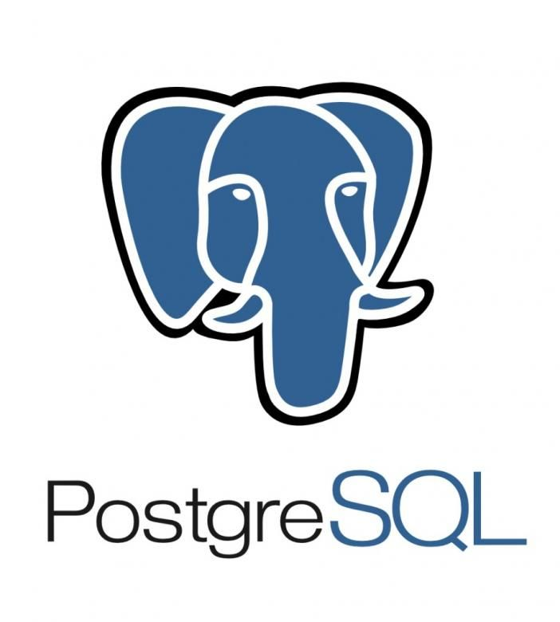
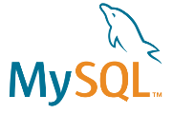

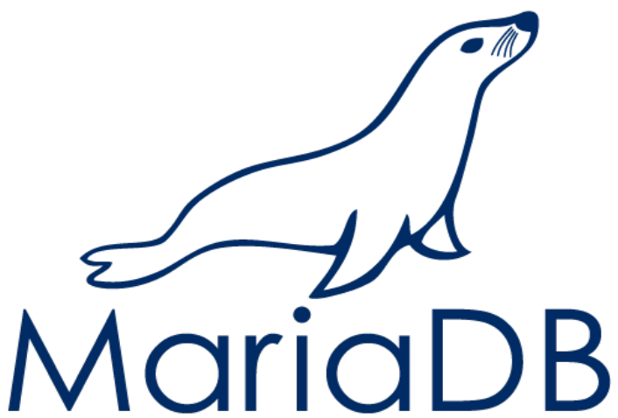






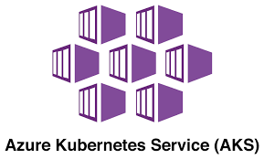
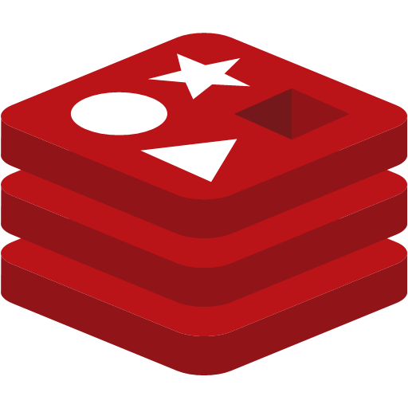
Linux and open source databases offerings on Azure
Unique Azure offerings for Linux and containers
Unique Azure offerings for SQL Server and open source databases
Integrated support
Azure Red Hat OpenShift
Ansible integration
JBoss integration
Integrated support
Azure Tuned Kernel
SAP integration
Azure Tuned Kernel
Fully supported on Azure
Fully managed container service
Red Hat
Compute options for every workload
Robust monitoring, backup and governance tools
Incentives to save money
Low TCO with built-in HA
Fully managed community versions
Industry-leading compliance and layers of security
Visual Studio and VS Code for Database services
Fully Managed Cache service with Redis for scalable apps
SUSE
Ubuntu
CentOS
Flatcar
Debian
SUSE
Red Hat
OpenShift
Notes:
We’re offering three unique value to our customers:
Over 50% of the Azure VM Cores are running Linux, and we’re continuously investing more in the Linux and Open Source world to make sure that the experience of running the Linux-based workloads are seamless.
Being a neutral technology provider, We have strong partnership with the Linux Distro publishers like Red Hat, SUSE and Canonical, to build co-developed applications, Azure Tuned Kernel and we jointly support our customers when they choose to run their Linux workloads on Azure, they can enjoy one ticket to solution experience.
Top 100 Microsoft Customers using Azure are running their mission critical workloads in heterogeneous environment, and we’re also contributing back to the upstream Linux and Open Source community, to ensure the best experience possible.
Linux on Azure ACOM site: https://azure.microsoft.com/en-us/overview/linux-on-azure/
3 key messages
#1 majority of Azure customer workloads run on Linux
#2 Our key strength is in our partnersships
AL2 competes directly with Red Hat
We partner closely with the top distro providers – for Red Hat and SUSE that means joint investments in support and product integration
It means Azure tuned kernels for optimal performance on the platform
Joint marketing, product development, lab development and training
We work very closely with SAP
- We recently started partnering with Oracle
#3 top enterprise customers trust Linux on Azure with their workloads
Linux workloads are among the fastest growing workloads on Azure. In fact, more than 50% of Azure VM cores are running Linux. Top 100 Azure customers are running Linux on Azure. ​
​
Microsoft has been investing heavily in Linux and Open Source to ensure the best experience of running Linux workloads on Azure. We have strong partnership with the Linux Distro publishers like Red Hat, SUSE and Canonical, to build co-developed applications, Azure Tuned Kernel. We jointly support our customers when they choose to run their Linux workloads on Azure, so they can enjoy integrated support and timely resolution.​
​
Linux on Azure ACOM site: https://azure.microsoft.com/en-us/overview/linux-on-azure/ ​

Slide 16
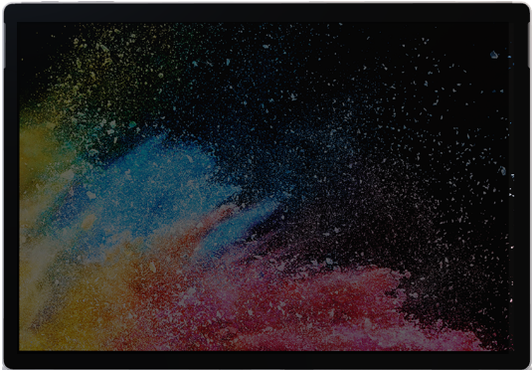

Quickly migrate virtual desktops and apps to Azure
Windows Virtual Desktop
Deploy and scale in minutes
Deliver the only multi-session Windows 10 experience
Enable optimizations for Office 365 ProPlus
Migrate Windows Server (RDS) desktops and apps
Windows 10
+
Office 365
Windows
Server
Notes:
Recently we’ve seen a significant customer adoption of Windows Virtual Desktop to enable remote work.
Windows Virtual Desktop is a comprehensive desktop and app virtualization service running in the cloud.
Windows Virtual Desktop provides the only virtualized multi-session Windows 10 desktop and is optimized to deliver the best Office 365 experience. Because it runs workloads in the cloud, you can take advantage of all cloud benefits from scale and speed to availability on any device.
Migrate your Remote Desktop Services (RDS) environment with simplified management and deployment experience on Azure.
Plus, quickly virtualize and deploy modern and legacy desktop apps to the cloud in minutes with unified management in the Azure portal. There is no need to provision new hardware, and you only pay for the infrastructure you use.
“…”
Key points to land
Text
Text
Text

Slide 17
Azure App Service
Only fully-managed service for any .NET web application
Automated load balancing and infrastructure maintenance
Scale your web applications on-demand
Reduce operational tasks, focus scarce IT resources on higher value work
Built-in autoscaling
Automated migration with App Service Migration Assistant
Notes:
Compatibility & support
Code parity: Same SQL Server Engine in both cloud and on-premises
Lift and shift on-prem applications without making code changes
99.99% SLA with backward compatibility through SQL Server 2005. (AWS RDS offers 99.95% SLA with support through SQL Server 2008.)
The only evergreen SQL service in the cloud: you'll never need to patch or upgrade ever again.
Per Forrester TEI, a payback period of less than 6 months.

Slide 18
Azure SQL enables on-demand scale and operational efficiencies
Use IaaS and PaaS options as appropriate to your use case
SQL
SQL Server on Azure Virtual Machines
Azure SQL
Managed Instance
Azure SQL Database
_{Best for lift and shift} _{and/or workloads requiring} _{OS-level access}
_{Best for modernizing} _{existing apps}
Best for supporting modern cloud apps
IaaS
PaaS
Notes:
The services within Azure SQL span both Infrastructure-as-a-Service and fully-managed Platform-as-a-Service and support a variety of scenarios:
SQL Server on Azure Virtual Machines
Lift-and-shift your SQL workloads with ease and maintain with 100% SQL Server compatibility and operating system-level access
Azure SQL Managed Instance
Modernize your existing SQL Server applications at scale with an intelligent fully managed service
Azure SQL Database
Support modern cloud applications on an intelligent, managed service that includes serverless compute

Slide 19


Common migration projects
Windows Server
SQL Server
Linux & open source databases
DevTest
Web apps
SAP
Specialized workloads
VDI
SAP
VMware
NetApp
Oracle
Notes:
These are the common migration projects and workloads we see customers migrating today.
Not all workloads are currently supported by AMP now, but we have plans to expand over time based on customer need.
A customer’s environment might also have multiple workloads so it’s important to understand the migratable estate in its entirety so you can have a conversation holistically.

Slide 20

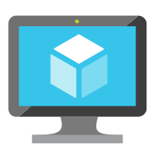
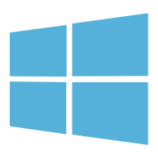

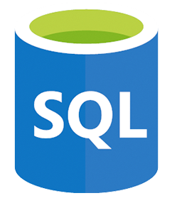


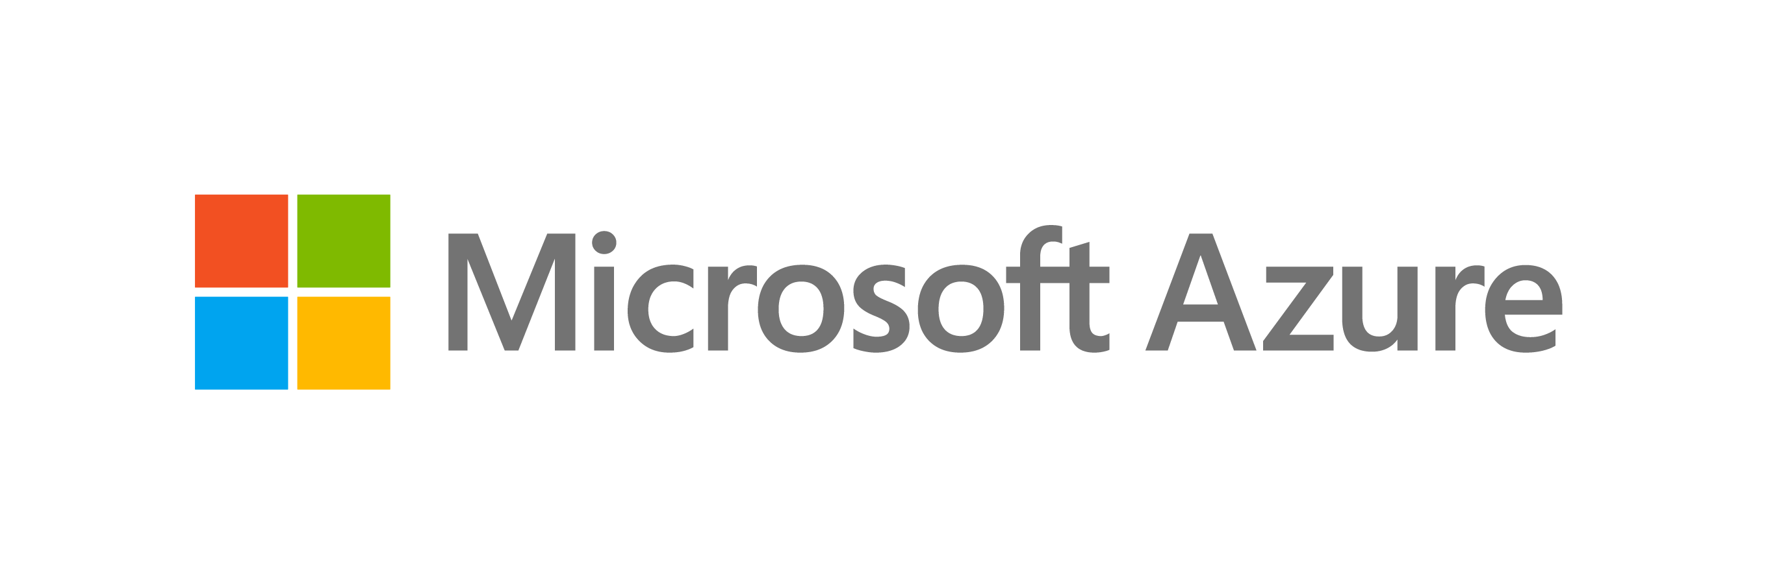
Migrating your workloads to Azure IaaS
LOB App
LOB App
Web/App layer
Azure IaaS
Azure Migrate – Server Migration
Data layer
Azure IaaS
VMware
aws
Google Cloud

Slide 21
Migrating your VMware-virtualized infrastructure to Azure VMware Solution
LOB App
LOB App
Web/App layer
Web/App layer
VMware tools
Data layer
Data layer
VMware
Azure VMware Solution

Slide 22
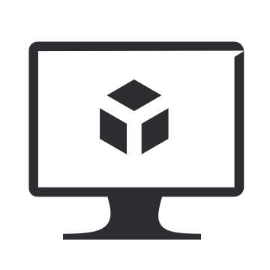

Migrating your Virtual Desktop Infrastructure (VDI) to Windows Virtual Desktop
VDI Deployment
VDI Deployment
Virtual Desktops (RDS/VMware/ Citrix)
Windows Virtual Desktop (native or VMware/Citrix)
Azure Migrate (integration with Lakeside for Assessment) Partner tools for Migration
VDI Infrastructure
Azure laaS
VMware
AWS
Google Cloud

Slide 23
Modernizing your .NET applications to Azure App Service & Azure SQL
LOB App
LOB App
Web/App layer (.NET)
Azure App Service
Azure Migrate – Server Migration
Data layer
Azure Migrate – Database Migration
Azure SQL
VMware
aws
Google Cloud

Slide 24
Key investments to lower migration costs and help you move with confidence
Microsoft Cloud Adoption Framework
Proven guidance to accelerate your cloud adoption journey
Azure Migration Program FastTrack for Azure
Best practices & resources, including Azure engineering & specialized partners
Azure Migrate
Single hub for all your migration needs
Notes:
We have a rich mix of process, tooling, and program investments to hep customers navigate the journey and be successful.
CAF is proven guidance with the stages you saw previously.
Azure Migrate is our unified toolset.
And finally, we have programs such as AMP and FTA to help customers successfully migrate.

Slide 25
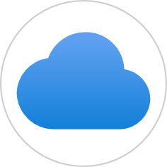



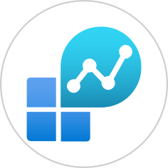
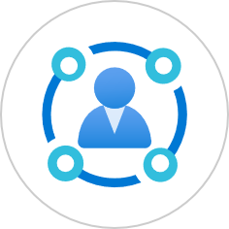
Your migration journey Informed by the Microsoft Cloud Adoption Framework for Azure
Pre-migration
Organizational change mgmt. is key
Adopt
Workload
migration
 
Ready
Tech skilling 
Landing Zone  
Manage
Operations  
Define strategy
Migration strategy
Center of excellence
Partner engagement
Plan
Assessment  
TCO/Business case  
Migration plan
Govern
Security   
Compliance   
People . Process  . Technology 
Notes:
This is a summary view of the migration journey – it has people, process and tech dimensions.
It starts with defining migration strategy, commissioning a CoE, & building the migration plan. The plan includes a priority set of workloads to move, resources, & concrete timelines.
And then we have an iterative process of building out the foundational infrastructure, executing workload migration in waves, and ongoing ops & governance – i.e., living the cloud lifestyle.
<Click>
The pre-migration stage is heavy on people and process – stakeholder alignment is the most important success factor.
Ultimately, migration is a massive org change mgmt. exercise – influencing the customer to define a cloud CoE/ Tiger team can help maintain the focus and urgency.
Execute migrations in waves. We recommend an iterative, wave-oriented approach to deeper technical assessments and migration. This means picking a manageable sized cohort of workloads/applications for each wave and using automation to move them over – in the Azure Migration Program, we’ve been running projects with 6-8 applications in a wave. This approach enables IT teams and partners work with application teams in a focused manner thereby increasing the chances of high-quality migration. Typical application owner concerns include rightsizing, comprehensive dependency mapping to ensure no component gets left behind, application & database compatibility, adequate testing before cutover, and adherence to change management windows. This does imply taking a conservative approach during the initial migration waves, but I’ve seen several application owners accelerate subsequent waves as they begin to reap the agility and on-demand scale benefits of cloud.

Slide 26
Azure Migration Program (AMP)
Optimize costs and migrate with confidence with the right expert help at every stage. Use best-practice guidance, direct access to Azure engineers, tools, and specialized partners.
Proven methodology: Cloud Adoption Framework
Free tools: Azure Migrate
Cost-effective offers & incentives
In-depth assistance from FastTrack for Azure engineers
Technical skill building
Expert help from specialized partners
Learn more & nominate | Azure.com/AMP
Notes:
The Azure Migration Program gives you prescriptive guidance for a step by step approach to cloud migration. AMP offers the opportunity to work closely with Microsoft experts and specialized migration partners to simplify and accelerate your migration.
The program delivers:
Best practices for a step by step approach from start to finish
Technical skill building to ensure your organization can successfully adopt Azure
FastTrack for Azure engineering assistance for data and infrastructure foundations
Expert guidance from specialized migration partners
Free Azure tools like Azure Migrate to help you efficiently execute migrations
And cost effective offers to help you save money before, during, and after migration

Slide 27
Azure Migrate A central hub for datacenter migration
Multiple scenarios
Migrate Windows and Linux Servers, Databases, Data, Web Applications and Virtual Desktops
Diverse capabilities
Comprehensive discovery, assessment, and migration capabilities powered by Azure and third-party tools
Azure Migrate
Centralized visibility
Centralized migration repository delivering end-to-end tracking and insights
Notes:
Discover, assess, and migrate on-premises applications, infrastructure, and data. Centrally plan and track the migration across multiple Microsoft and independent software vendor (ISV) tools.
A comprehensive approach to migrating your application and datacenter estate. Supports key migration workloads like Windows Server, Linux, SQL and other Databases, data with Data Box, Web Applications, and Workstations (including Virtual Desktop Infrastructure). Holistic across VMware, Hyper-V, physical server, and cloud-to-cloud migration.

Slide 28
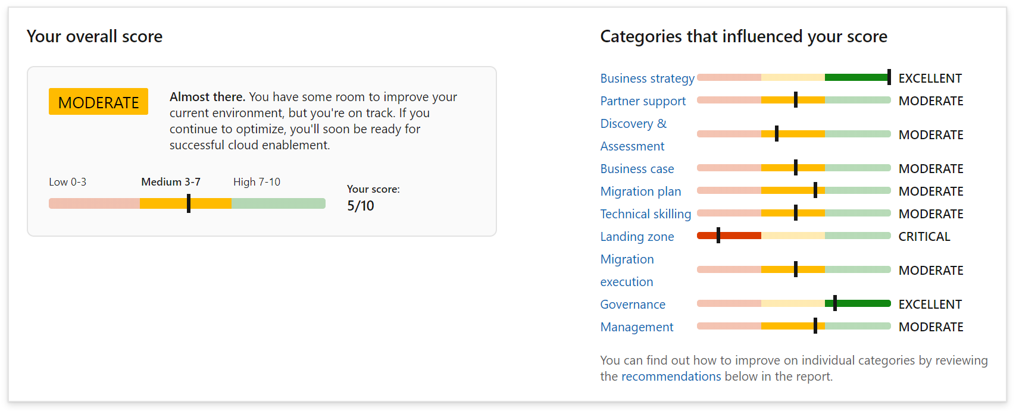
Assessing migration readiness is a good place to start
Strategic Migration Assessment & Readiness Tool (SMART)
aka.ms/smarttool
Notes:
A great first step is to help customers understand their readiness to migrate. We have released a readiness heatmap tool to help customers do this by distilling our real life experience running migration engagements. The heatmaps help us identify the areas where customers need help.

Slide 29
Next steps
Learn more and find resources
Azure.com/migration
Sign up for assistance
Azure.com/AMP
Azure.com/fasttrack
Understand Azure migration readiness
aka.ms/smarttool
Assess and move your workloads
aka.ms/azuremigrate

Slide 31

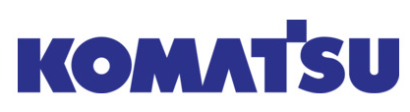
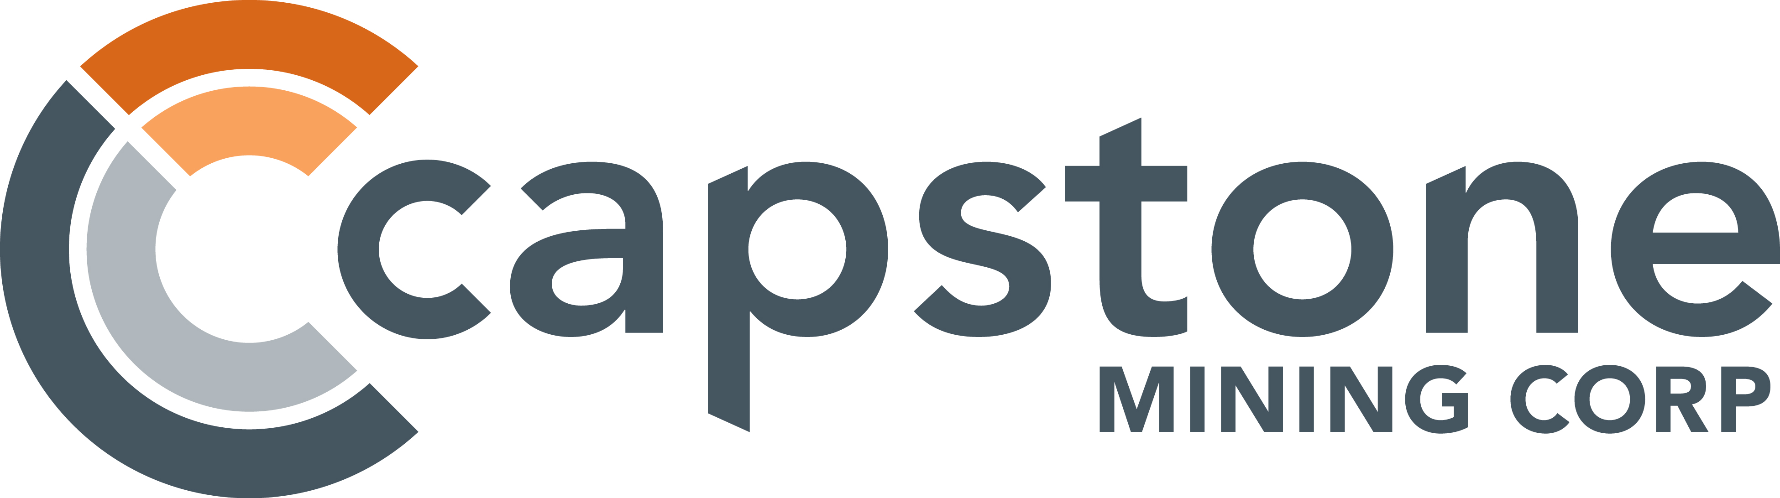
Customer success
We determined Azure SQL Database Managed Instance was the best choice for us in terms of scalability, cost, and performance.… We’ve seen a 49 percent cost reduction and 25 to 30 percent performance gains.
Nipun Sharma, Analytics Architect, Business Technology and Systems, Komatsu Australia
One of our big objectives was to eliminate $3 million in capital costs over about three years, and to reduce our operating costs by approximately the same amount,” says Slattery. “At the same time, we wanted to improve our quality of service. With Azure, we’re confident that we’ll meet those goals.
Jim Slattery, Chief Financial Officer, Capstone Mining
Notes:
Our customer momentum is clear on migration. Komatsu was able to see a 49% cost reduction and 25-30% performance gain by migrating its data bases to Azure. Capstone Mining eliminated millions in capital costs and operating costs.

Slide 32


Customer success
To use on-premises datacenters, you have to make this huge initial investment to start using the technology. With the cloud, you don’t need to stock up on components. You can just leverage the technology right away.
With the move to Azure, the hospital cut its data backup costs by half. We were able to save almost 50 percent by hosting our disaster recovery environment for Epic and other critical systems in Azure other than the databases that are always on and always replicating, we can spin down the whole virtualized environment so it runs idle. It’s very low cost. Even more remarkable, the project teams built the cloud infrastructure in just three months.
Daniel Breton, Infrastructure Manager, The Ottawa Hospital
https://customers.microsoft.com/en-us/story/772376-ottawahospital-healthprovider-azure-canada

Slide 33
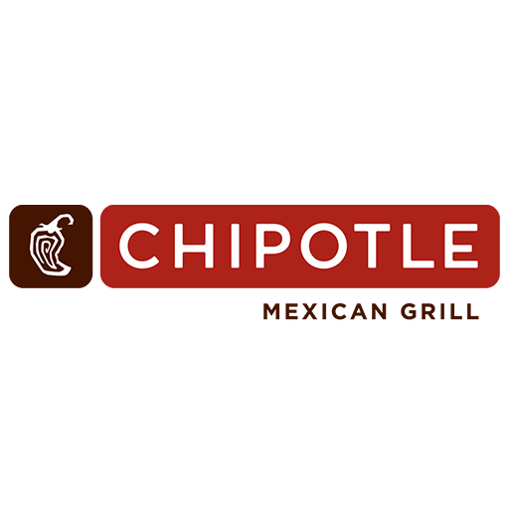


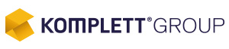
Customer success
Our move to .NET Core, Visual Studio Code, TypeScript, and Azure services worked out just like we had planned. Our new website makes us much more agile in supporting Chipotle’s primary mission: bringing people responsibly sourced, classically cooked, real food, with wholesome ingredients.
Mike Smith, Lead Software Developer, Chipotle Mexican Grill
We needed to redesign Premera.com to create a unified, seamless experience for our customers. So, we chose Azure.
Tom Craig, Senior Cloud Engineer, Digital Customer Experience (DCX), Premera Blue Cross
The biggest difference this year was ease of scalability. Last year we depended on adding physical hardware way ahead of the event, adding cost and complexity. This year, we saw more than 500 views a second and delivered 21 TB of data to our customers, with great response times. Using Azure, we were easily able to scale on demand to get the performance we needed.
Thomas Wilhelmsen, Head of IT Operations, Komplett
Notes:
Many customers are migrating to the cloud to scale their most demanding workloads—for example, e-commerce web sites (Komplett) or health care portals (Premera)—to drive cost savings and reliability.

Slide 34


Customer: CIBC
Industry: Financial Services
Country: Canada
“We are on a multi-year transformation journey, and cloud migration is an important first step.
Azure Migration Program offered the right mix of training, best practice guidance, tooling, and specialized partners to best meet our needs. Importantly, Microsoft was prepared to work hand in hand with us and showed deep commitment to our success.”
Marc Gunter Vice President of Infrastructure, Planning and Engineering
Notes:
“We are on a multi-year transformation journey, and cloud migration is an important first step.
Azure Migration Program offered the right mix of training, best practice guidance, tooling, and specialized partners to best meet our needs. Importantly, Microsoft was prepared to work hand in hand with us and showed deep commitment to our success.”
Marc Gunter, Vice President of Infrastructure, Planning and Engineering Canadian Imperial Bank of Commerce, CIBC

Slide 35
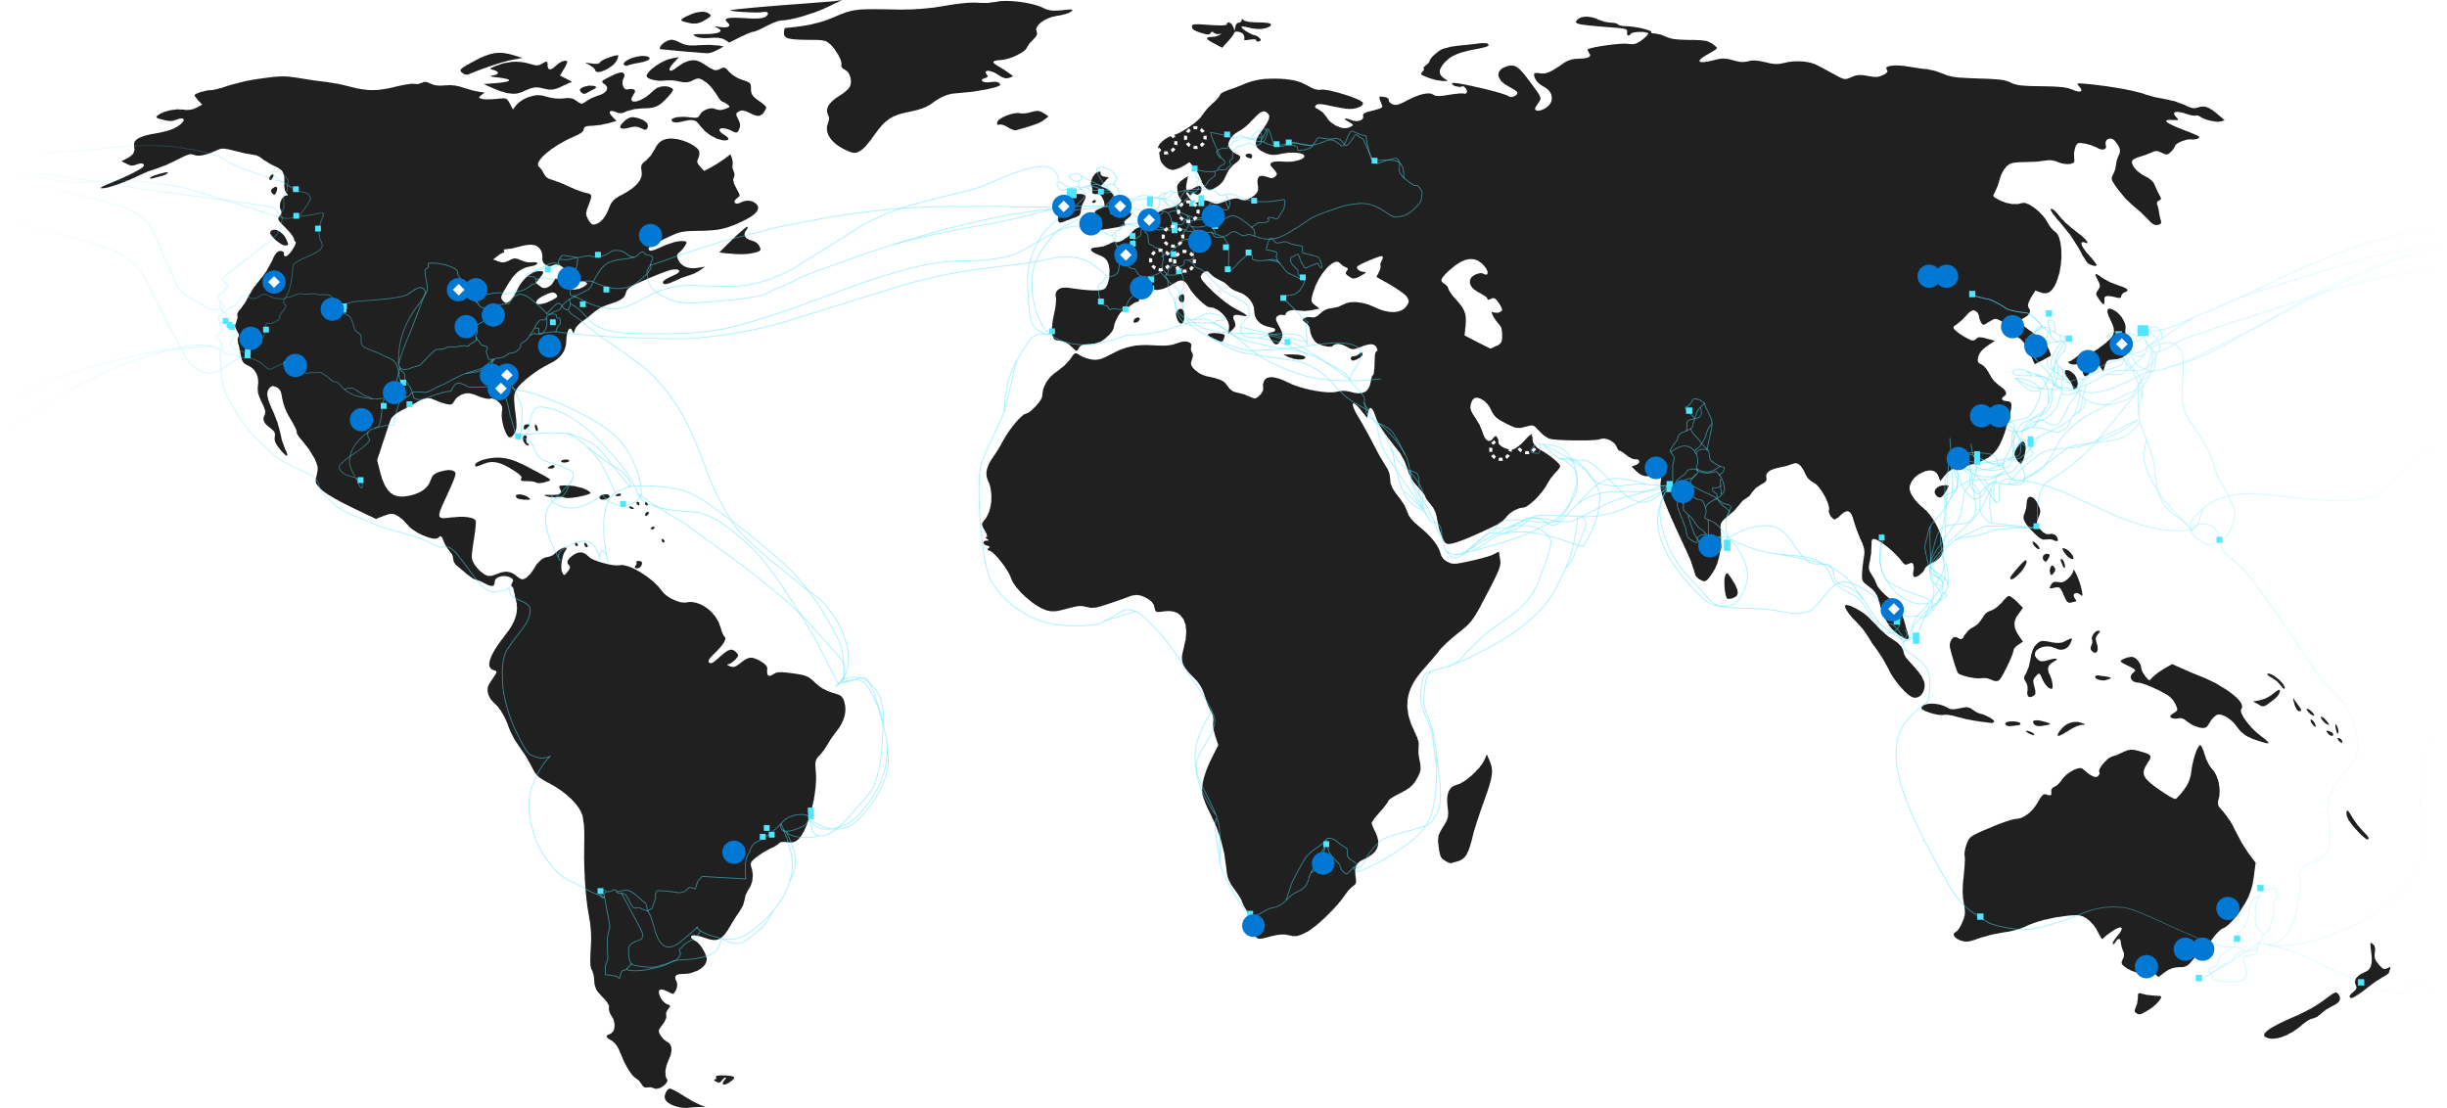
More regions than any other cloud provider
Available region
Announced region
Availability zones
Edge sites
WAN links
60
Regions worldwide
130K+
Miles of fiber and subsea cable
160+
Edge sites
200+
ExpressRoute partners
Notes:
This map outlines the massive scale of Azure.
Azure is available in 60 regions worldwide, more than any other cloud providers
We have one of the largest global networks, over 130,000 miles of fiber on land and sub-sea.
We have 160+ edge sites, pairing points, that allow customers to bring their networks and connect them to ours. Our list of regions and edge sites continues to expand.
Data that traverses between Azure datacenters and regions remains in Microsoft’s network and does not flow over the public Internet. This includes all traffic between Microsoft services anywhere in the world.
For example, within Azure, traffic between virtual machines, storage, and SQL communication traverses only the Microsoft network, regardless of the source and destination region. Intra-region VNet-to-VNet traffic, as well as cross-region VNet-to-VNet traffic, stays on the Microsoft network.
Additional notes for speaker background
The reliability and performance of cloud services is determined in part by the network and (in addition to having more datacenter regions than any of our competitors) Microsoft’s network is also one of the largest in the world.
The Microsoft global wide-area network (WAN) plays an important part in delivering a great cloud service experience – offering near-perfect availability, high capacity, and the flexibility to respond to unpredictable demand spikes.

Slide 36
No migration is ever linear or simple Drawn from 100s of engagements by FastTrack for Azure
Security and compliance
Migration plan
Specific migration workloads committed
Azure Foundations
Migration training
Technical skilling
Azure administration
Business strategy
Migration plan
Infrastructure security
Data protection
Incident response
Operations model
Technical resources
Cloud Strategy Team In Place (CDE)
Project management resources
Logging and monitoring
OS patching
High level business strategy
Key stakeholder sign off
Migration funding committed
Subscription design
Text
Text
Text
Text
Text
Text
Text
Text
Text
Text
Text
Text
Text
Text
Text
Text
Text
Text
Text
Text
Text
Text
Text
Text
Text
Text
Text
Text
Text
Text
Text
Text
Text
Text
Text
Text
Text
Text
Text
Text
Text
Text
Text
Text
Monitoring
Identity and access management
Backup
Financial analysis
Governance
Landing zone
Migration execution
Security RACI
Disaster recovery
TCO/ business case
Networking
Customer/ partner contract
Migration strategy
Identity
Shared responsibility model understood
Cloud operations
Configuration and change management
Pilot applications and VM identification
Partner support
Migration partner
Cost management
Cloud operational processes and run books
e2e test
Migration execution
Migration support
DevOps and automation
Azure operations partner
Migration targeted scope
Migration factory offering
Scan
Assessment
Workload owner buy-in or alignment
Discovery and assessment
Notes:
Real life migrations can be complex and messy to navigate.
This is from our FTA team which has been working with many many customers…

Slide 37
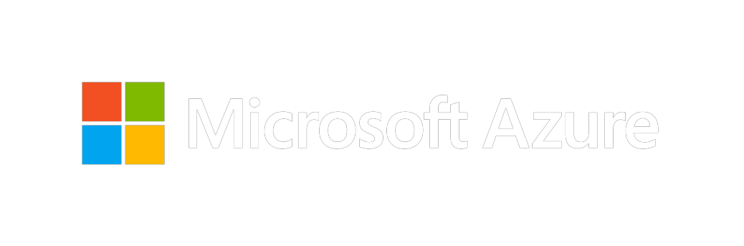
Thank you for joining us.
© 2018 Microsoft Corporation. All rights reserved. Microsoft, Windows, Windows Vista and other product names are or may be registered trademarks and/or trademarks in the U.S. and/or other countries.
The information herein is for informational purposes only and represents the current view of Microsoft Corporation as of the date of this presentation. Because Microsoft must respond to changing market conditions, it should not be interpreted to be a commitment on the part of Microsoft, and Microsoft cannot guarantee the accuracy of any information provided after the date of this presentation. MICROSOFT MAKES NO WARRANTIES, EXPRESS, IMPLIED OR STATUTORY, AS TO THE INFORMATION IN THIS PRESENTATION.

